Slide 1

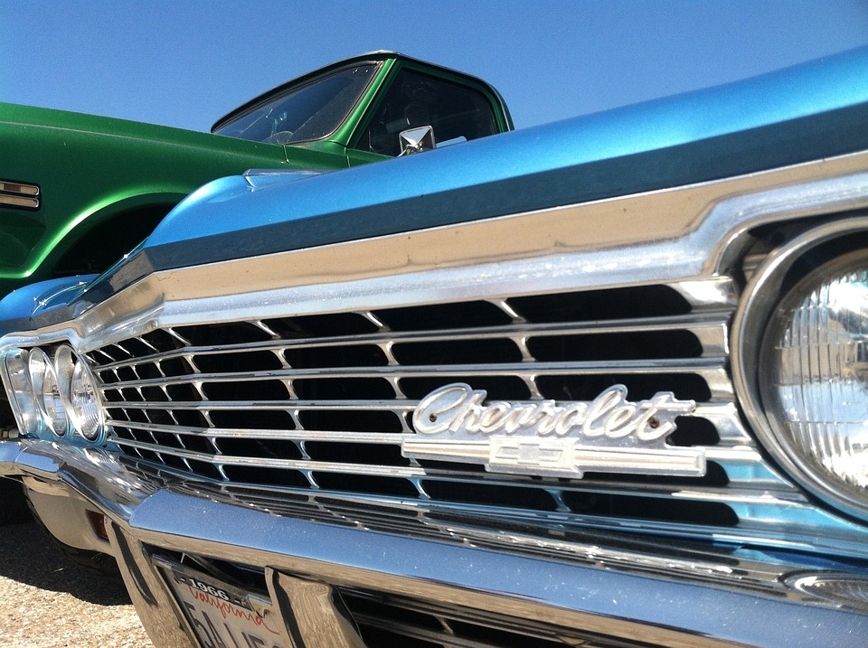
Analyzing the Impact of Car Features on Price and Profitability
Abhishek Adyani

Slide 2
Agenda
1
2
3
4
5
Introduction
Tech-stack used
Insights & Dashboard
Conclusion
Result

Slide 3
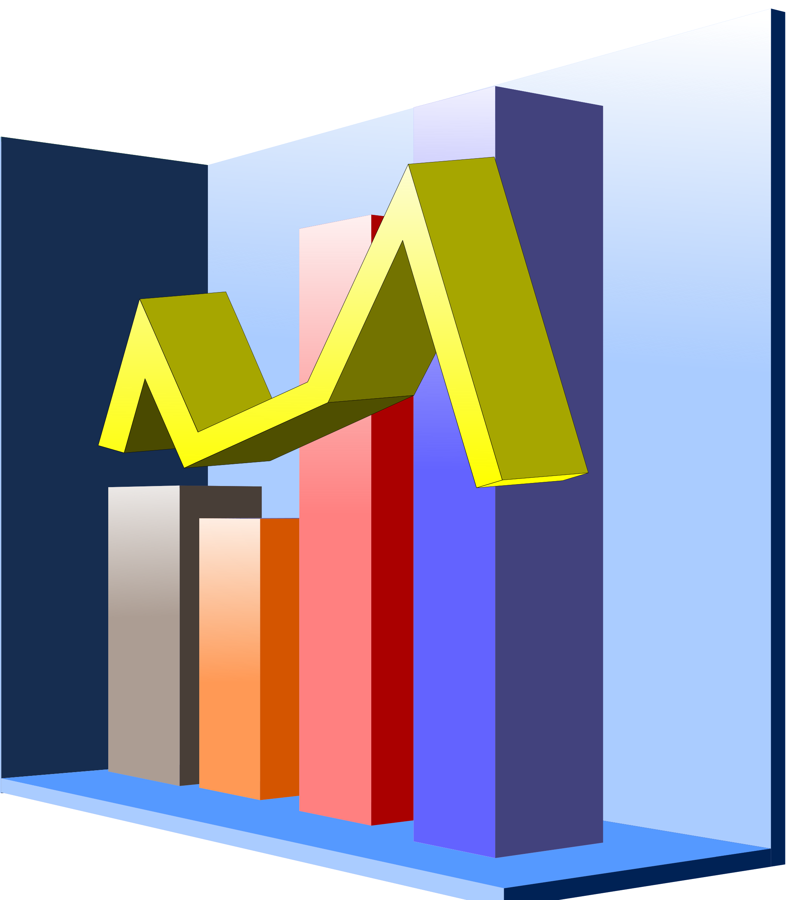
Introduction
Project Description
The automotive industry has been rapidly evolving over the past few decades, In recent years, there has been a growing trend towards electric and hybrid vehicles, for that the client has asked how can a car manufacturer optimize pricing and product development decisions to maximize profitability while meeting consumer demand?
What I will be doing
I will be approaching the problem by analyzing the relationship between a car's features, market category, and pricing, and identifying which features and categories are most popular among consumers and most profitable for the manufacturer.
Insights
The insights could help the manufacturer improve its competitiveness in the market and increase its profitability over time.

Slide 4

Tech-stack used
MICROSOFT EXCEL 2021
I used this software as it has various functions that are convenient and faster to use. It helps in drawing meaningful conclusions and to create visualizing data to understand the problem clearly and to make data driven decisions.

Slide 5





Data Cleaning
Understand the given dataset thoroughly, find the blank values in the data, remove the unnecessary column and perform descriptive statistics wherever necessary.
There are 4 columns with null values, I have imputed the values from online data from www.cars-data.com, as the null values were not more than 70 and can be imputed online easily
Checked for duplicate values and found out there were 715 duplicate values and removed them.
Analyzed the data and performed various univariate and bivariate analysis.
Made various graphs for understanding the data more clearly, and made an interactive dashboard for client.

Slide 6
Null Values

Slide 7






Insights

Slide 8
1) How does the popularity of a car model vary across different market categories?
We can see from the chart that some of the most popular market category for car models are FLEX FUEL, CROSSOVER, HATCHBACK, PERFORMANCE with average popularity and high model count. HYBRID is the most popular market category with the lowest model count.

Slide 9
2) What is the relationship between a car's engine power and its price?
As the engine horsepower increases price of the car also increases, there’s a positive relation between the two.

Slide 10
3) Which car features are most important in determining a car's price?
From the graph we can conclude that ENGINE CYLINDERS are the most important variable in determining the price of a car.

Slide 11
4) How does the average price of a car vary across different manufacturers?
BUGATTI has the highest average price and PLYMOUTH has the lowest average price, as the graph determines.

Slide 12
5) What is the relationship between fuel efficiency and the number of cylinders in a car's engine?
There’s negative correlation between them means, as the number of cylinders increases highway MPG decreases.

Slide 13
Building the dashboard

Slide 14
1) How does the distribution of car prices vary by brand and body style?
CHEVROLET has the highest price distribution by body style.

Slide 15
2) Which car brands have the highest and lowest average MSRPs, and how does this vary by body style?
BUGATTI has the highest average price by body style whereas PLYMOUTH has the lowest average price by body style.

Slide 16
3) How do the different feature such as transmission type affect the MSRP, and how does this vary by body style?
As we can see AUTOMATED_MANUAL with COUPE body style is the most expensive transmission.

Slide 17
4) How does the fuel efficiency of cars vary across different body styles and model years?
From the graph we can see fuel efficiency of cars has increased over the years across different body styles. The highest fuel efficiency is of WAGON body style in the year 2017.

Slide 18
5) How does the car's horsepower, MPG, and price vary across different Brands?
From the graph we can conclude that as the ENGINE HP increases, MPG decreases but PRICE (MSRP) increases.

Slide 19
Conclusion
Most popular market category for car models are FLEX FUEL, CROSSOVER, HATCHBACK, PERFORMANCE
CHEVROLET has the highest price distribution by body style.
AUTOMATED_MANUAL with COUPE body style is the most expensive transmission
If engine power increases, price of car also increases
BUGATTI has the highest average price and PLYMOUTH has the lowest average price.

Slide 20
Conclusion
If the number of cylinders increases highway MPG decreases
WAGON body style has the highest fuel efficiency
BUGATTI has the highest average price by body style whereas PLYMOUTH has the lowest average price by body style
If the ENGINE HP increases, MPG decreases but PRICE (MSRP) increases
ENGINE CYLINDERS are the most important variable in determining the price of a car

Slide 21
Google Drive Link
I have made an interactive dashboard in excel, the google drive link for that is given below, please ctrl+click to see the dashboard
DASHBOARD LINK

Slide 22

Result
The project was quite challenging and taught me a good amount things about how a automotive industry maintains it’s business and what type of questions you have to ask to gain profitability in the market. I also used various functions and charts to understand the data and chug out the important insights for the automotive industry.

Slide 23
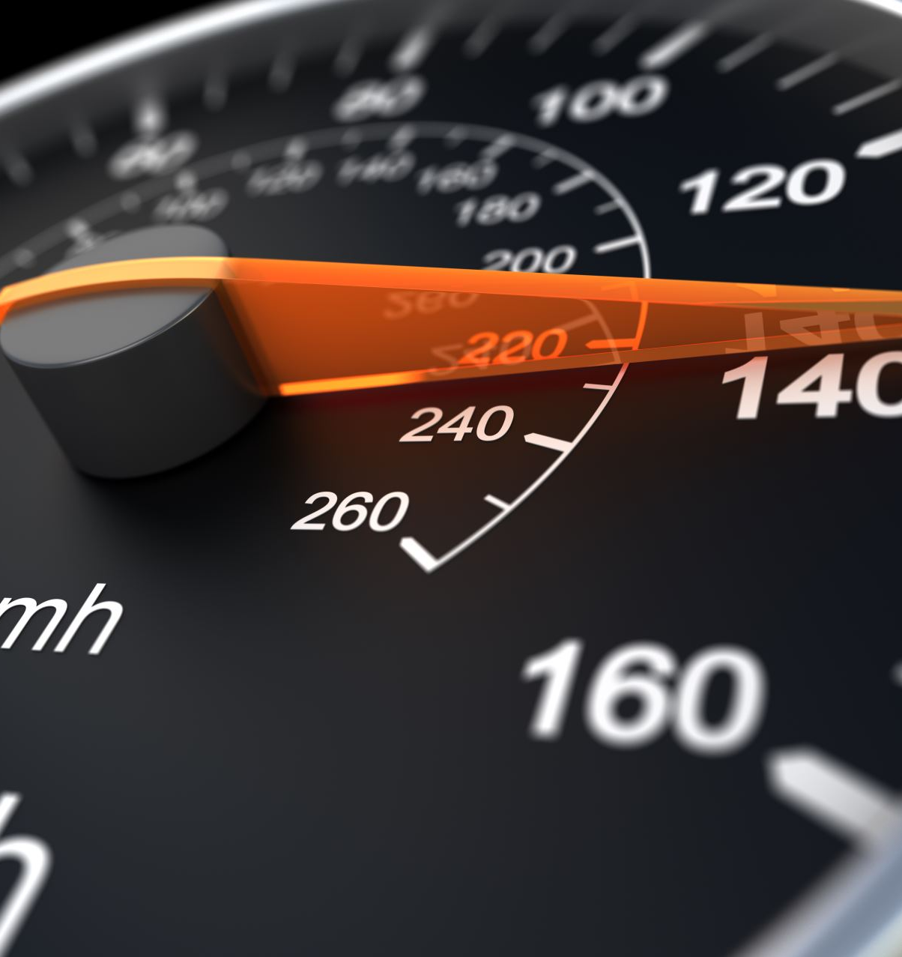
Thank you
Abhishek Adyani
iabhishek0109@gmail.com

